Slide 1
Investigating Gender Bias with LLMs
Emma Stein
Supervisors: Dr. Terry Ruas and Jan Philip Wahle
07/16/2024
‹#›

Slide 2
Outline
Motivation
Past approaches
Research Questions
Methodology
Results & Takeaways

Slide 3
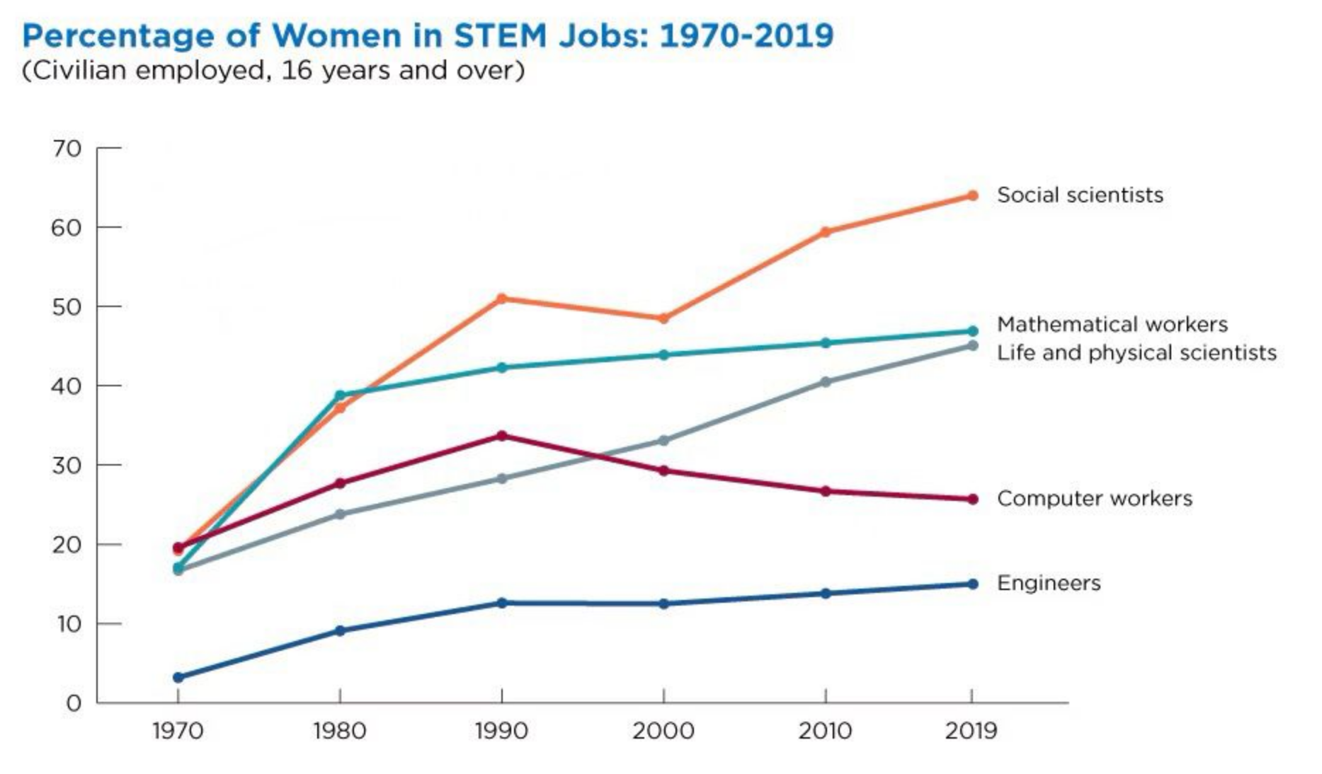
Motivation
We still have unbalanced gender distributions in many fields:
modified from: https://www.census.gov/library/stories/2021/01/women-making-gains-in-stem-occupations-but-still-underrepresented.html

Slide 4
Motivation
Moral argument:
Equality
Economic arguments:
Loss of talent
Widening of applicant pool

Slide 5
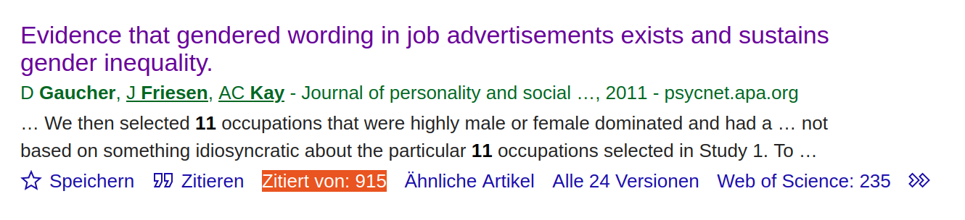


Motivation
One way to combat this: change wording of job descriptions
Issues: focus on job descriptions, manual
implementations
Our approach: university program
descriptions, LLMs, automated established metrics
Bring men into female dominated jobs too!
U..S. Bureau of Labour Statistics: https://www.bls.gov/cps/cpsaat18.htm

Slide 6
Motivation: Why LLMs?
Manual implementation is costly and slow
LLMs have been able to find interesting correlations between gender and language before
Bolukbasi, Tolga, et al., (2016): Man is to computer programmer as woman is to homemaker? debiasing word embeddings
Avoid human biases (but introduce LLM biases)
What are the dangers of biased program descriptions being written by LLMs?
Especially interesting for the Digital Humanities: Biases in LLMs/using LLMs to combat biases

Slide 7
Research Questions
RQ1: How good are LLMs at generating paraphrased program descriptions?
RQ2: Do LLMs agree with traditional metrics of gendered language?
RQ3: How do LLMs „think“ about gendered language?

Slide 8
Methodology

Slide 9
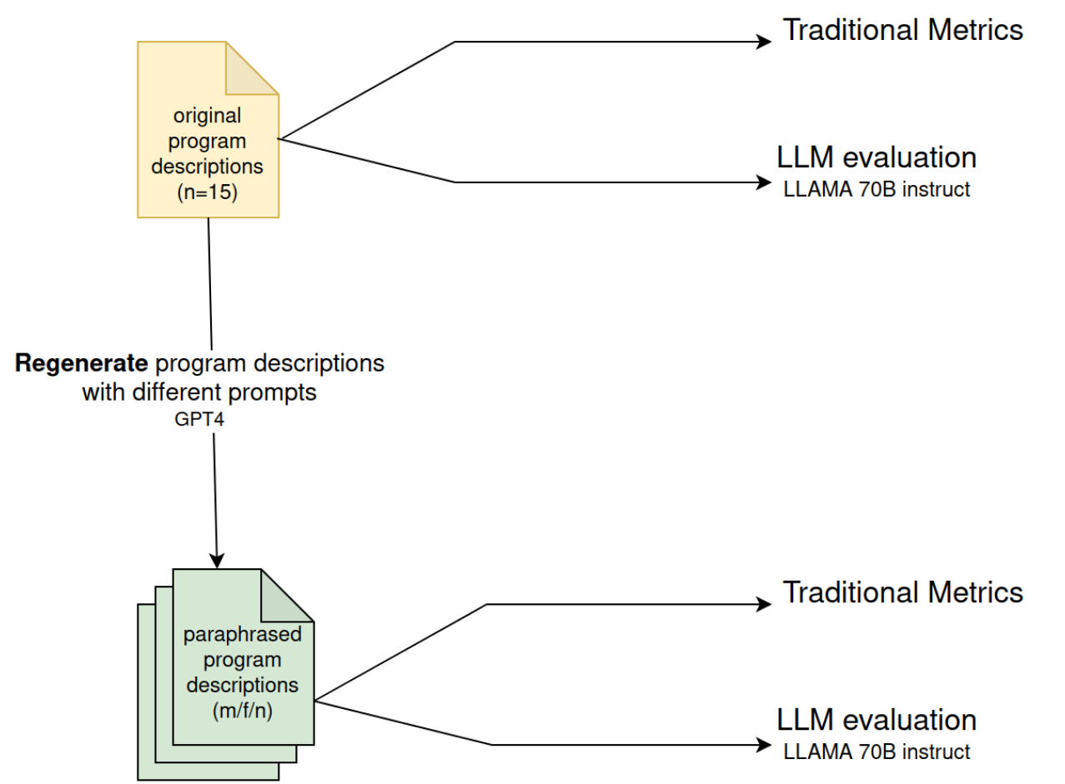
Methodology: An overview

Slide 10
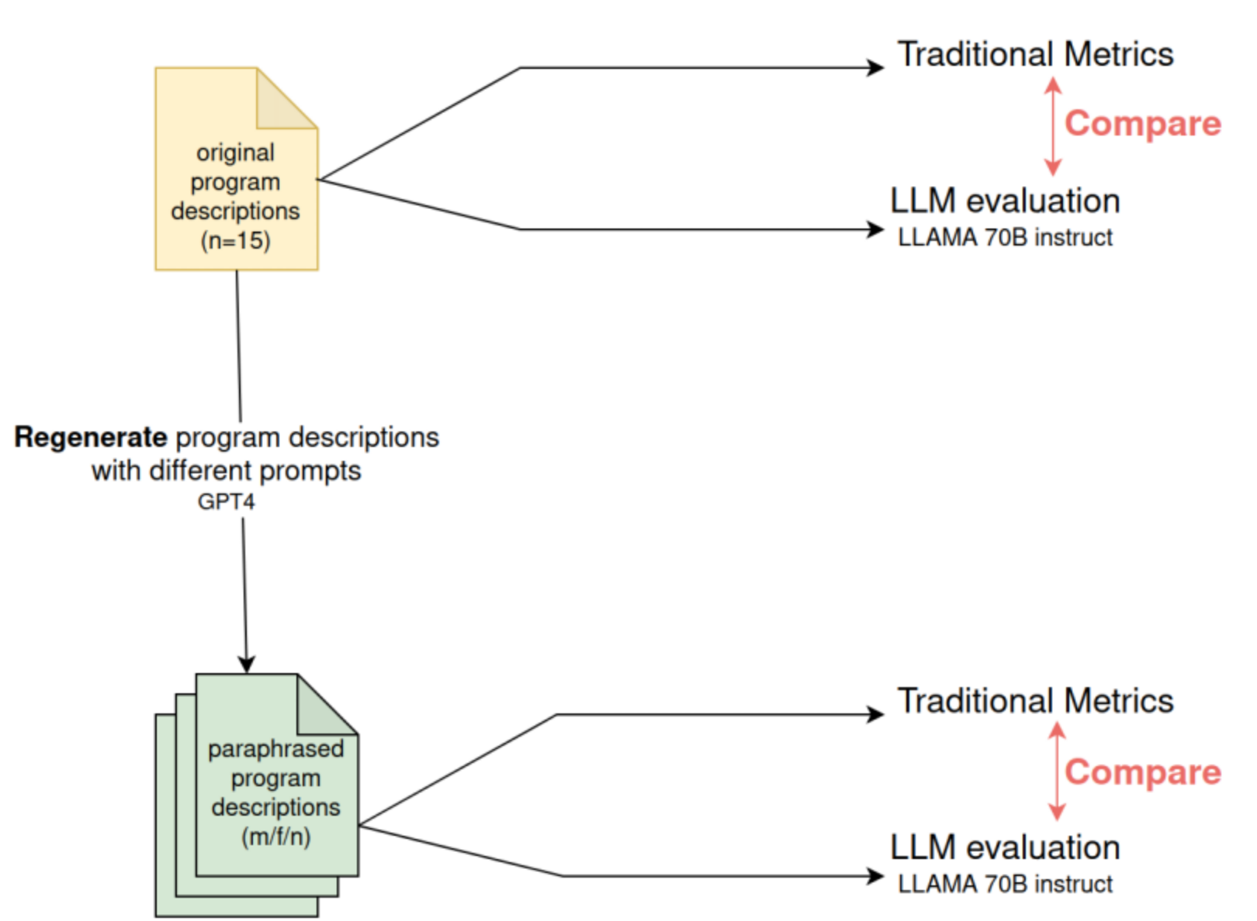
Methodology: RQ2

Slide 11
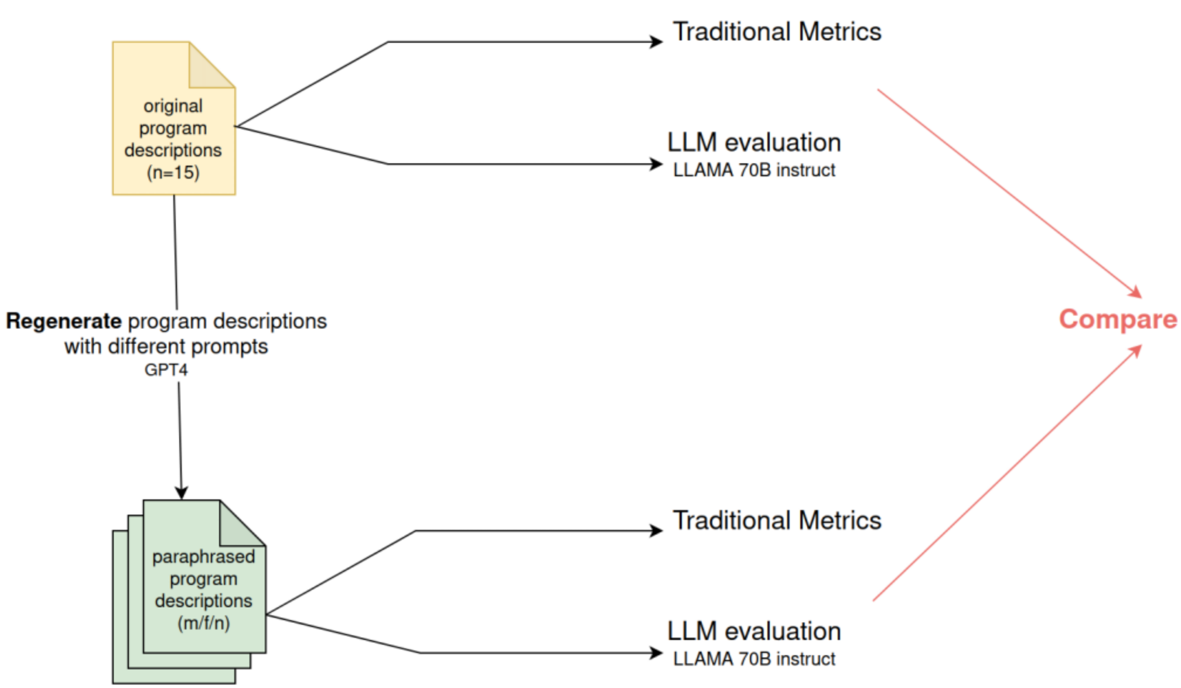
Methodology: RQ1, RQ3

Slide 12
Task Overview
Data collection
Which program descriptions to use? How should they be collected?
Implementing traditional metrics
Literature research on previous approaches. Which metrics were used? What did they find?
Automation of traditional metrics
Prompting
Design prompts for classification
Design prompts for generating paraphrases
Analyse and evaluate results

Slide 13
Data collection
N= 15 program descriptions
5 each: male, female, balanced
English program descriptions
Programs offered by the University of Göttingen
Excluded:
Phd programs
No (proper) English translation
Small number of students enrolled (n<=15)

Slide 14
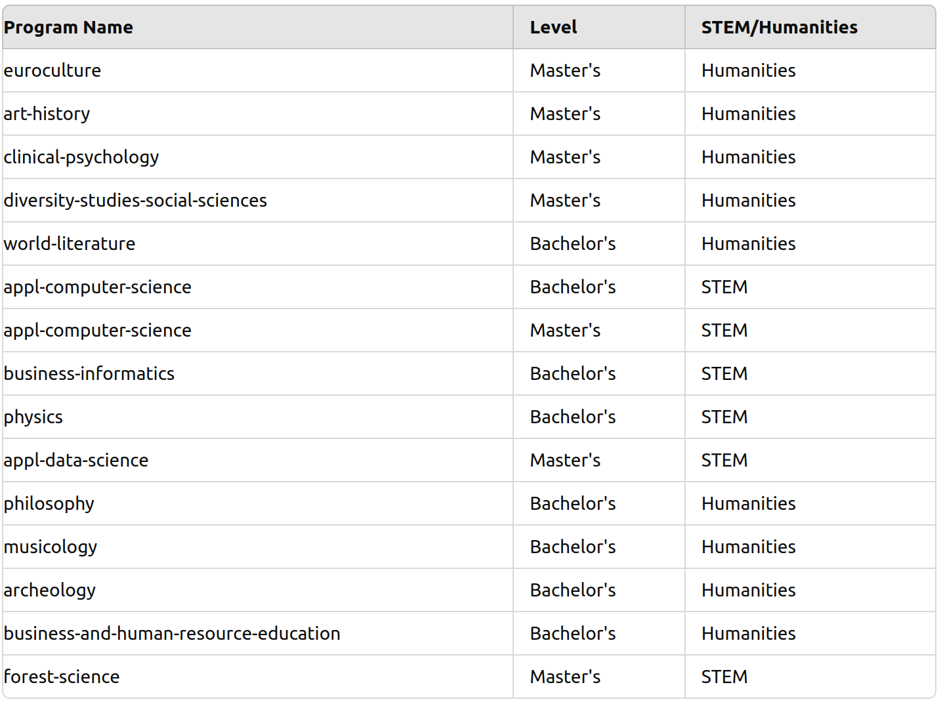
Data collection
Typical components:
Description of the field, skills required, practical applications, job opportunities

Slide 15
Traditional Metrics:
Agentic/Communal [Gaucher, Friesen, Kay 2011]
Measure what values a text appeals to
Automation using lemmas
Count occurrences for each dimension and weight male versus female
Trait/Behavior [Wille & Derous 2018]
“You are a calm person” versus “you act calmly”
Measured using the LCM and Brysbaert abstraction scores

Slide 16
LLM classification of gender orientation
LLAMA-3-70B-instruct, API endpoint by KISSKI
Chain of thought [Zhang et al. 2022]
Rate gender orientedness as one of 5 categories: neutral, moderately male/female or strongly male/female oriented
Return: json with classification, reasoning and confidence level
It was surprisingly hard to get models to comment on this

Slide 17
Generating paraphrases
Paraphrase each program description as:
Targeted at male, female, neutral.
Total of 45 paraphrased program
descriptions
GPT-4, OpenAI API
Different model for evaluation and paraphrase to ensure independent judgement
Prompts were written by a previous student:

Slide 18
Generating paraphrases
You are the coordinator and responsible for writing academic program descriptions for a university. , You need to rewrite the current program description delimited by triple quotes for the university website . This description was written by a previous program coordinator in order to attract <GENDER> candidates to the program, but the percentage of <GENDER> did not change after that. Rewrite the text to make more <GENDER> want to apply to this program. Use a vocabulary that speaks and correlates to <GENDER> according to your understanding. Please also incorporate the values that are important to <GENDER> in the text to help improve the program description. The resulting text should be cohesive and follow an academic style of writing. Please think and organize your tasks step-by-step. The text is the following:
“”” <TEXT>
“””
Taking on a persona gave more distinguished results

Slide 19
Results

Slide 20
RQ1: How good are LLMs at generating paraphrases?
We use three metrics to evaluate the paraphrased texts:
Agentic/communal
LLAMA classification
Trait/behavior
What would “success” in generating paraphrases mean?
The texts rewritten as male also get scored as more male, ideally by multiple metrics. The same goes for female and neutrally paraphrased texts.
Is this the case?

Slide 21
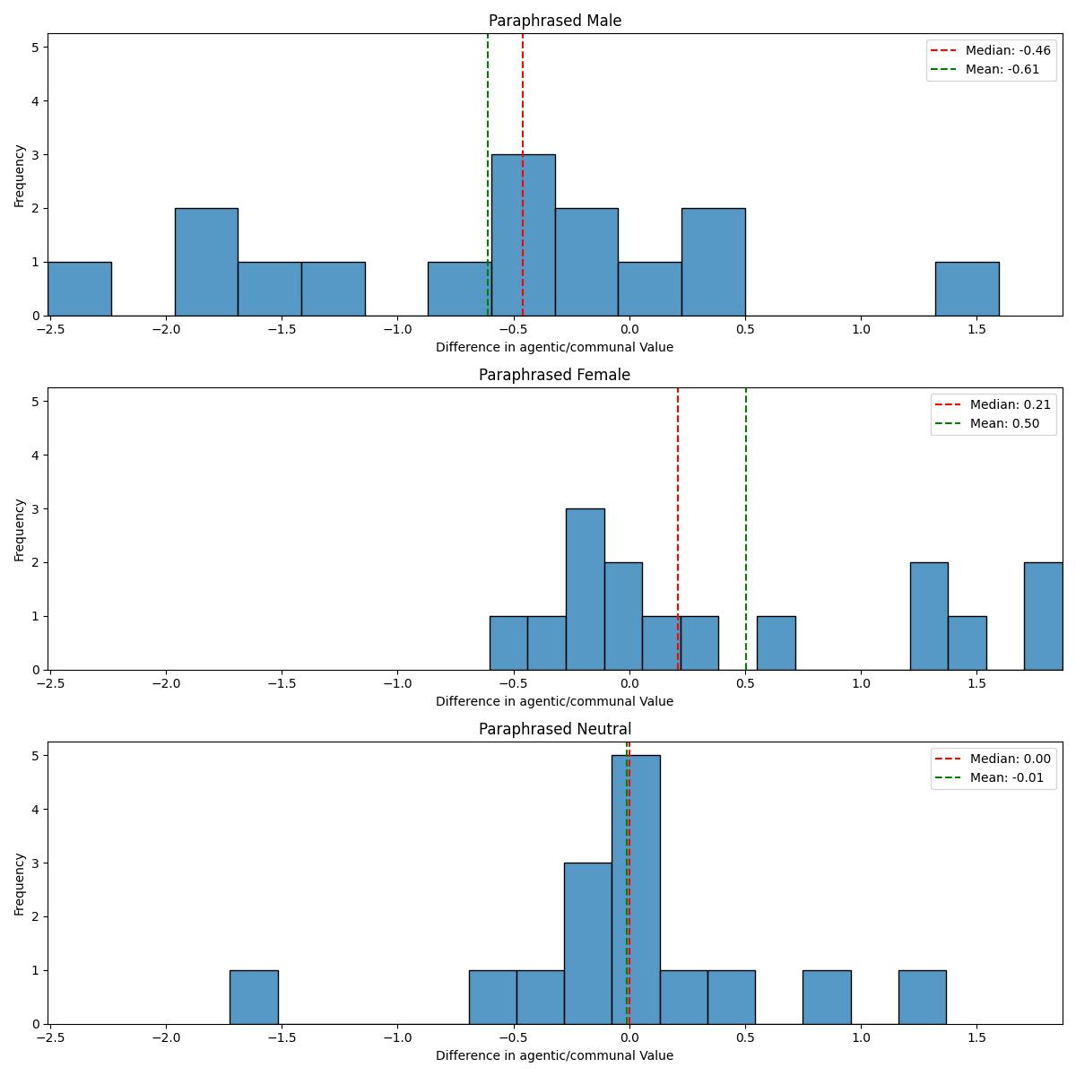
RQ1: How good are LLMs at generating paraphrases?
Agentic/communal:
Higher score = female
Lower score = male
Texts that are paraphrased as male/female also show a matching value shift
Neutral texts stay the same
Successful paraphrases?
Yes!

Slide 22
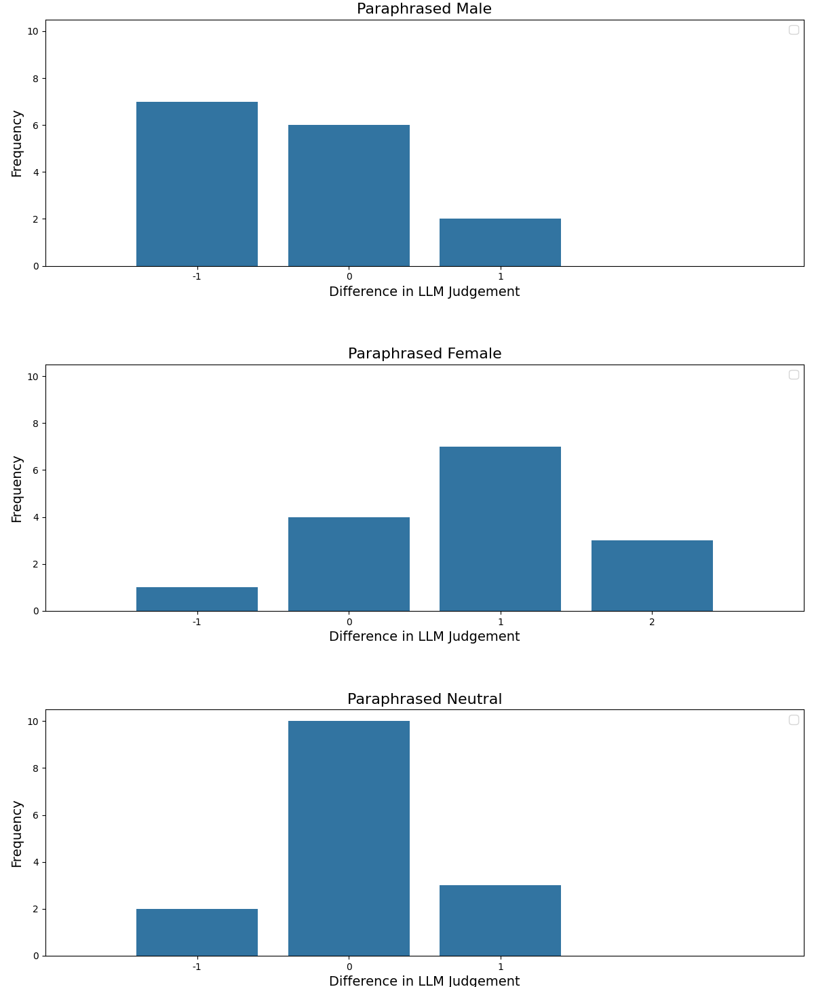
RQ1: How good are LLMs at generating paraphrases?
LLAMA classification
Categorical rating:
Strongly male oriented
Moderately male oriented
Neutral
Moderately female oriented
Strongly female oriented
Successful paraphrases?
Yes!

Slide 23
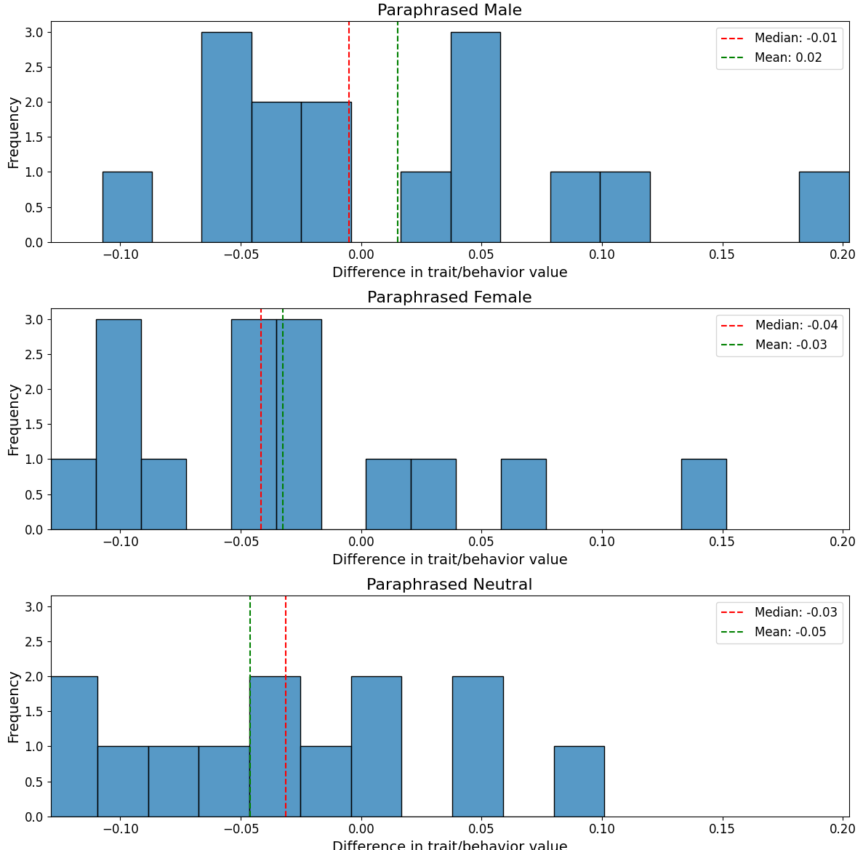
RQ1: How good are LLMs at generating paraphrases?
Trait/behavior
Lower score -> behavior
Higher score -> trait
Not as clear a result as for the other metrics
Sidenote: Paraphrases are consistently close to the original texts. Mean cosine similarity of embeddings: 0.87, standard deviation: 0.05

Slide 24
RQ2: Do LLMs agree with traditional metrics?
One way to answer: In how many cases do agentic/communal and LLAMA agree?
Translate agentic/communal to a five fold categorical value and compare the outcomes:
Kendall’s Tau for agentic/communal and LLMs: 0.14
Kendall’s Tau for trait/behavior and LLMs: 0.21
No (strong) evidence that metrics and LLAMA's judgement are correlated
The interesting part here is this: Why is agreement so low?

Slide 25
RQ2: Do LLMs agree with traditional metrics?
Why is agreement so low?
LLAMA hardly assigns extreme scores
This reflects what we’ve already seen during prompting
LLAMA hardly predicts female scores. Does not predict a single female score for the original program descriptions

Slide 26
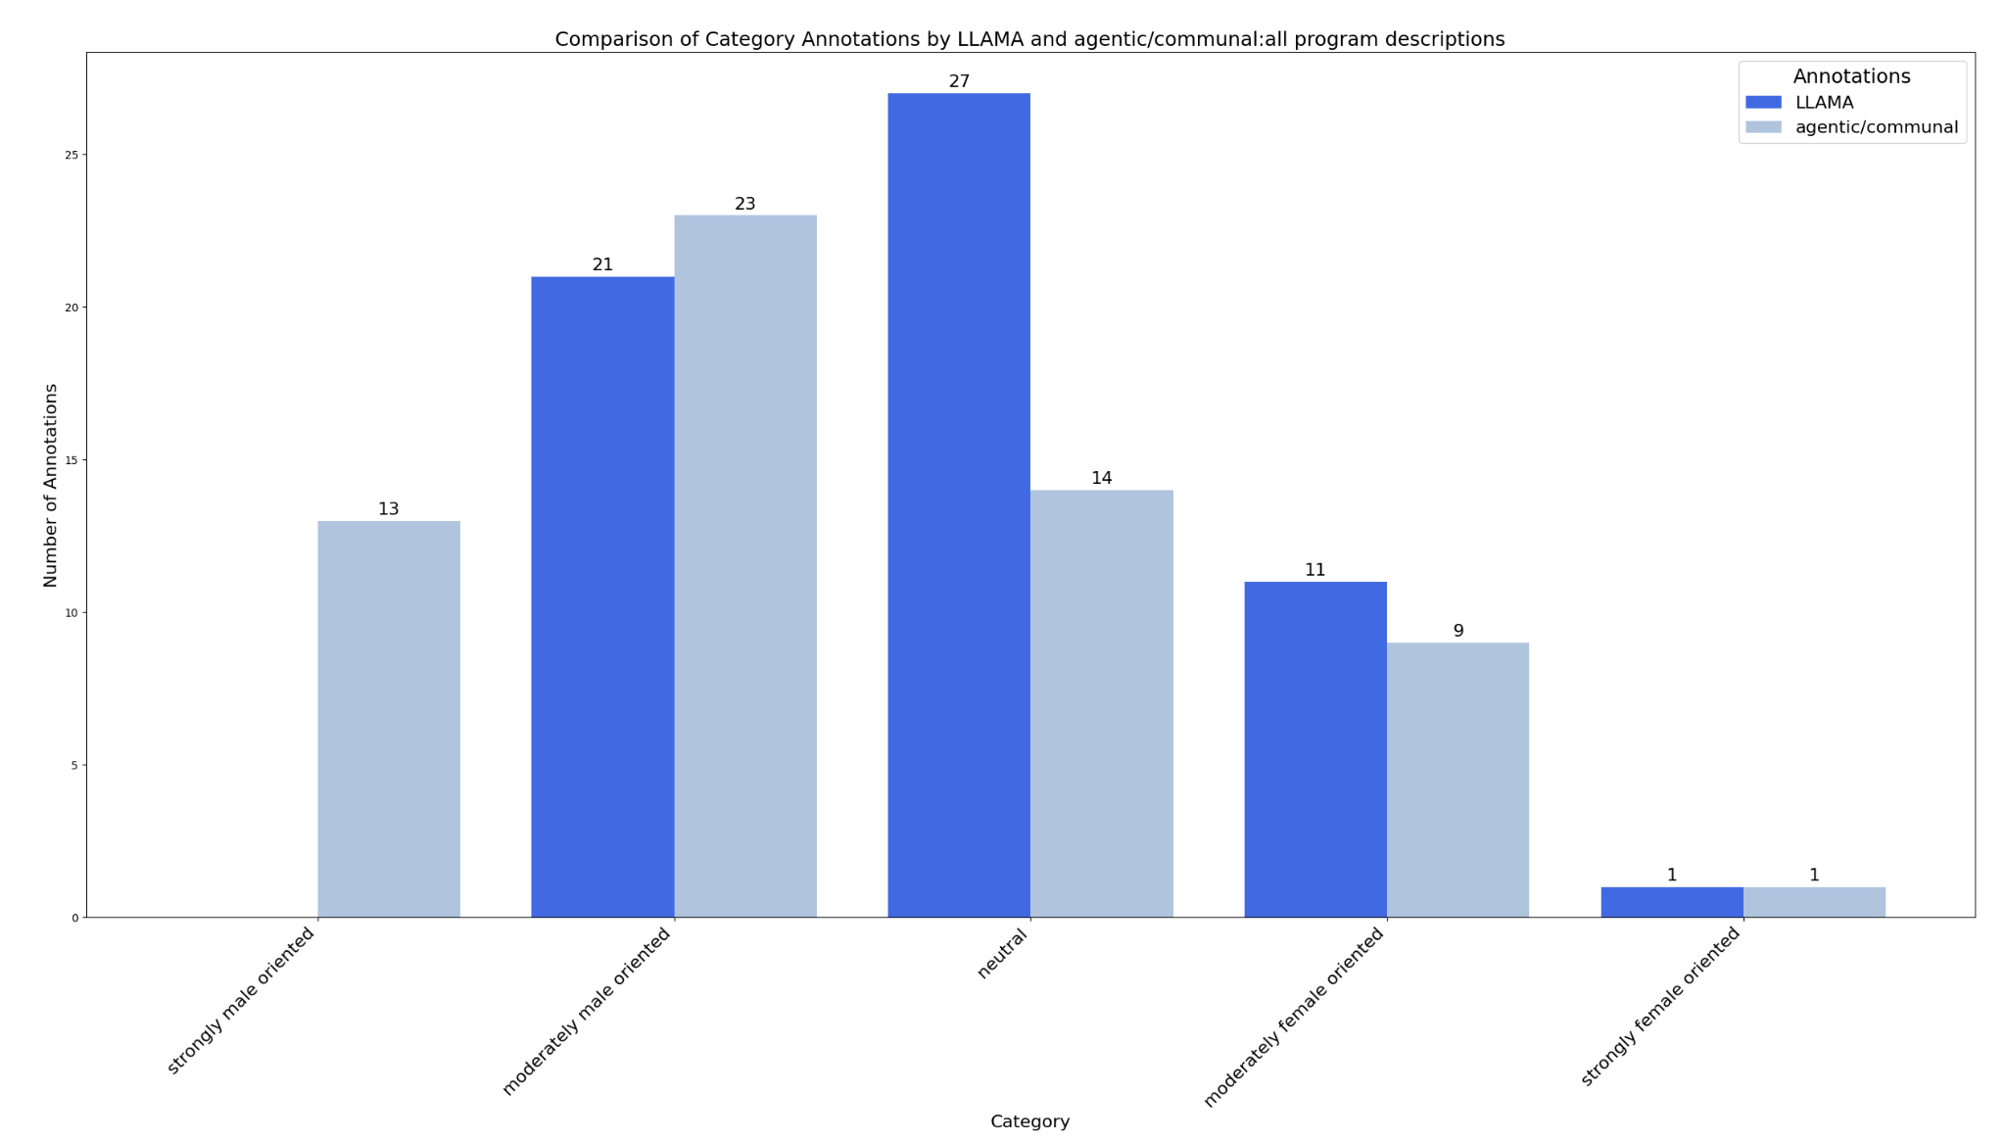
RQ2: Do LLMs agree with traditional metrics?

Slide 27
RQ2: Do LLMs agree with traditional metrics?
Why is agreement so low?
So do LLAMA and traditional metrics not agree at all then?
But there are similarities if we look beyond just matching of annotations…

Slide 28
RQ3: How do LLMs “think” about gendered language?
To answer this, we can look at two things:
What do the models paraphrase?
What reasoning do they provide for their classification?
Let’s look at the paraphrases first. An example: World literature

Slide 29
RQ3: How do LLMs “think” about gendered language?
original
This study program will invite you to explore literature of all major world regions. The extraordinary variety of European and non-European philologies at the University of Göttingen allows for a global study of literature. You will read prominent works of literatures of the world and examine their temporal, spatial and cultural allocations. The degree program is aimed at applicants who want to turn their interest in literature into their profession or whose career goal requires broad cultural knowledge.
paraphrased male
Dive into the dynamic world of global literature with our integrated study program. Harness the unique opportunity to explore philologies from all major world regions at the prestigious University of Göttingen. This program is designed for those who seek to transform their passion for literature into a rewarding career, providing the necessary cultural acumen and analytical prowess.

Slide 30
RQ3: How do LLMs “think” about gendered language?
What makes a text gender oriented in the paraphrased texts?
Male:
prestige, excellence, logic, career, competitiveness, power
Female:
interdisciplinary work, collaboration, societal impact, support
Back to RQ2: These are pretty similar to the values listed for agentic/communal

Slide 31
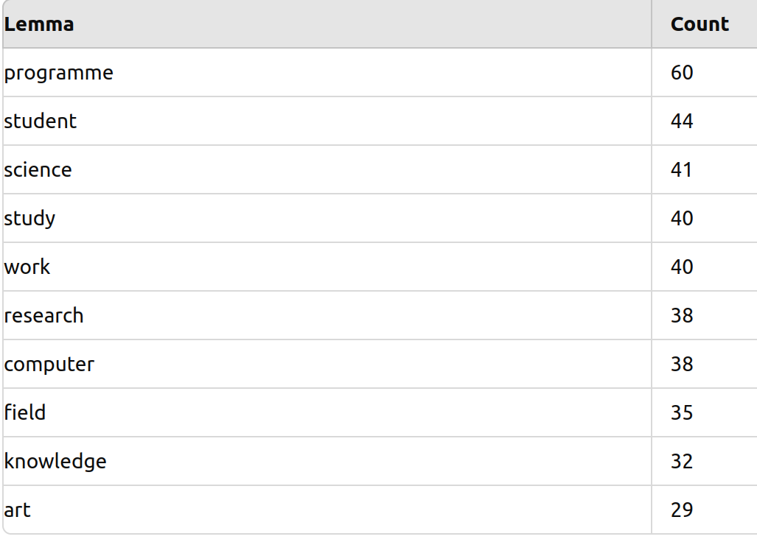
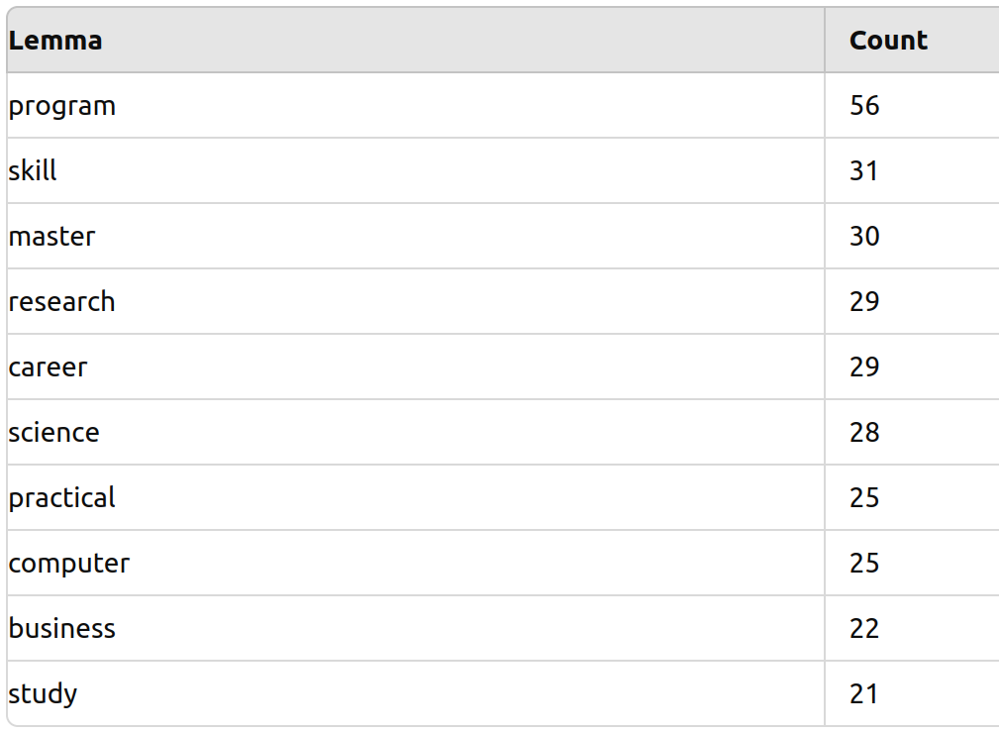
RQ3: How do LLMs “think” about gendered language?
Comparison of n-grams frequencies for the original (left) and paraphrased male program descriptions (right):

Slide 32
RQ3: How do LLMs “think” about gendered language?
Second factor to look at for the RQ: reasoning for classification
A common pattern:
Explicit mentions of gender (high weight)
Pronouns (high weight)
Weigh “gendered” expressions against each other
What gender the field is typically associated with
Overall style/register (academic,...)
Interesting parallels between agentic/communal metric and the LLM
LLM expressions as an extension of agentic/communal?

Slide 33
Takeaways
LLMs can generate paraphrases targeted at specific genders -> might need a human eye on the style
LLMs focus less on subtle linguistic markers of gender orientedness (instead: pronouns, explicit mentions,...)
LLMs can prove an interesting extension of traditional metrics
LLMs are much more sensitive to language that is biased against women than against men

Slide 34
Limitations and Outlook
Limitations:
More facets of gender
Multiple societal factors influence applications
Outlook:
Human evaluation
What are the effects of:
Different model sizes
Different architectures
…

Slide 35
Contact and Reproducibility
Reproducibility
Every LLM query was made using a seed to ensure replicability. Find models, scripts, prompts and hyperparameters here: https://github.com/stonehenge0/LLM_bias. The GitHub will be made public after the term paper is submitted.
emma.stein@stud.uni-goettingen.de

Slide 36
Questions?

Slide 37
Traditional Metrics (1): Agentic/communal
Agentic/communal
[Gaucher, Friesen, Kay 2011]
Measure what values a text appeals to
Assign lemmas to either the agentic (male
oriented) or communal (female oriented)
dimension
Automation: Count occurrences and weight against each
other

Slide 38
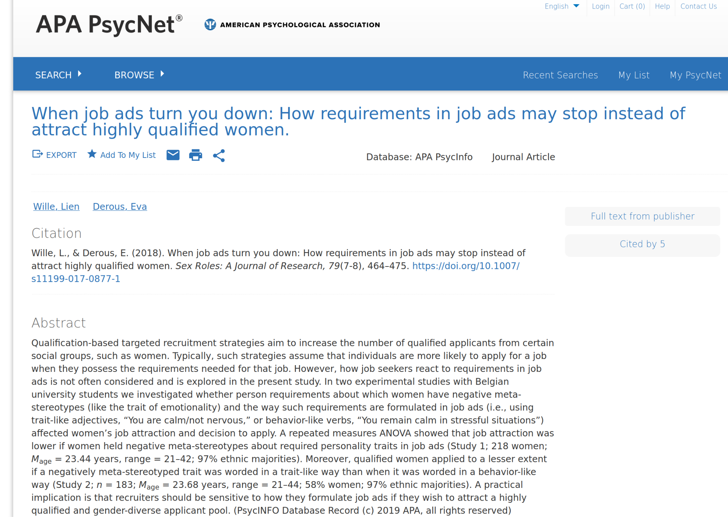
Traditional Metrics (2): Trait/behavior
How are desirable skills worded?
[Wille & Derous 2018]
Wording as a trait or wording as a behavior: “You are a calm person” versus “You react calmly“
Automation:
Measure level of linguistic abstraction -> LCM
Brysbaert abstraction scores averaged across the text

Slide 39

Traditional Metrics: An example
Traditional Metrics:
Agentic/communal Trait/behavior

Slide 40
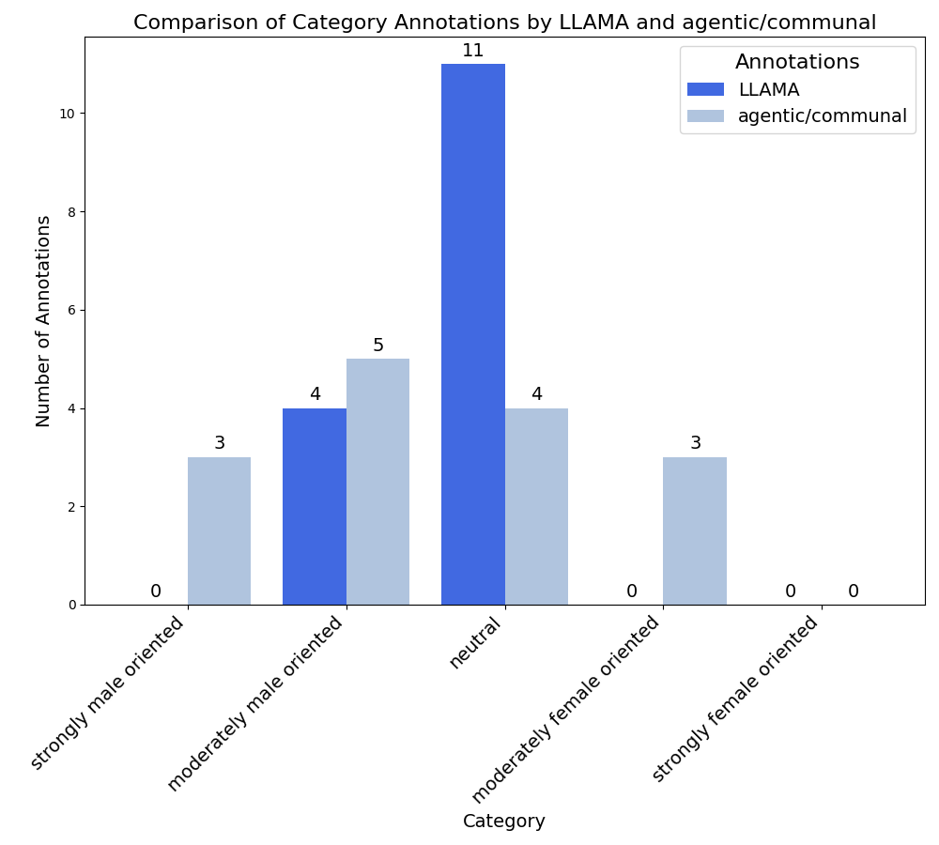
RQ2: Do LLMs agree with traditional metrics?
Why is the agreement so low?
For the original program descriptions: LLAMA hardly predicts no female oriented scores

Slide 41
RQ3: How do LLMs “think” about gendered language?
Some snippets from the n-grams analysis:
LLMs frequently add a “career” part (in all paraphrased texts)
For the female paraphrased texts “diverse”
Explicit mentions of women in many paraphrased female texts. Not a single one in the male texts.

Slide 42
RQ3: How do LLMs “think” about gendered language?
paraphrased neutral
The Literature Program at the University of Göttingen is designed to immerse students in the diverse spectrum of literary works from across the globe. Leveraging the extensive array of European and Non-European philologies present at our university, this program offers a comprehensive exploration of world literature. Students will engage with prominent works and investigate their historical, geographical, and cultural contexts. This degree is ideal for those aspiring to turn their passion for literature into a profession or those seeking a career that demands a broad understanding of cultural knowledge.

Slide 43
Recap: Research Questions
RQ1: How good are LLMs at generating paraphrased program descriptions?
RQ2: Do LLMs agree with traditional metrics of gendered language?
RQ3: How do LLMs „think“ about gendered language?

Slide 44
